Slide 1


ROAD SAFETY
A proposed strategy on how we can raise awareness of Road Safety in Kenya

Slide 2
PART 1
What Is Road Safety?
Road Safety Awareness
PART 2
Road Safety Statistics
Table Of Contents
PART 3
Causes Of Road Fatalities
PART 4
Burden Of Road Traffic Crashes And Injuries
PART 5
Road Safety Policies And Guidelines And Its Advantages

Slide 3
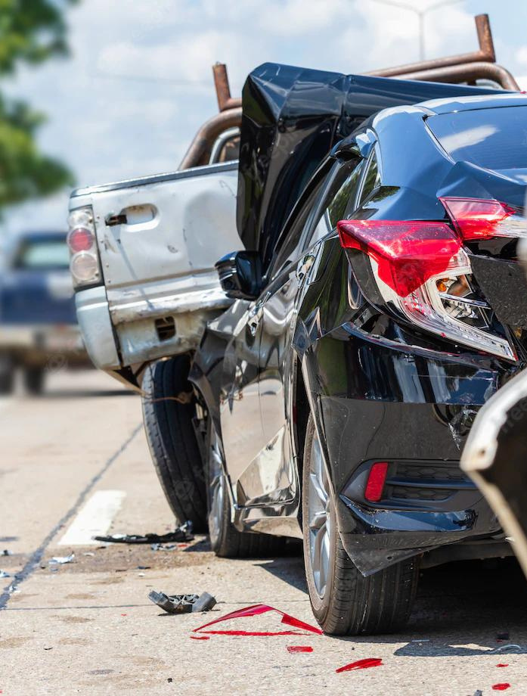
Road Safety Awareness
Our mission is simple and impactful:
To spread awareness of Road Safety in Kenya, the major causes of road accidents and the road safety policies and guidelines.

Slide 4
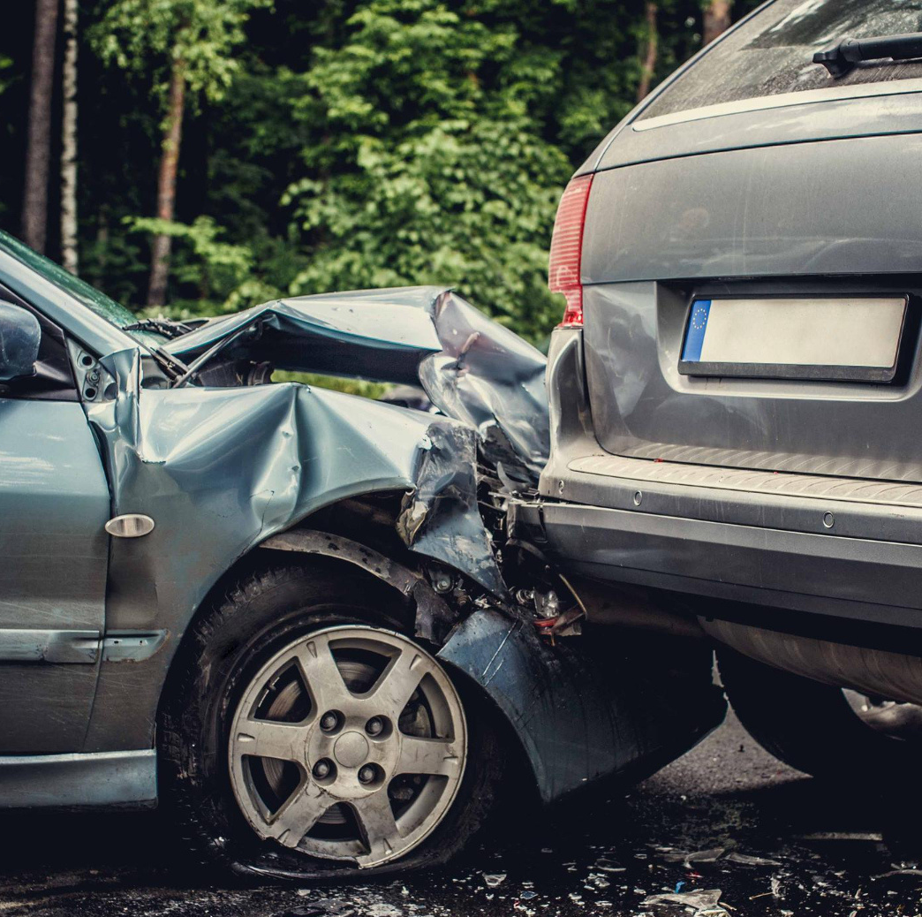
PART 1
MEANING OF ROAD SAFETY

Slide 5

Road Safety Awareness
WHAT IS ROAD SAFETY?
It refers to the methods and measures used to prevent road users from being killed or seriously injured.
Typical road users include pedestrians, cyclists, motorists, vehicle passengers and passengers of on-road public transport.

Slide 6
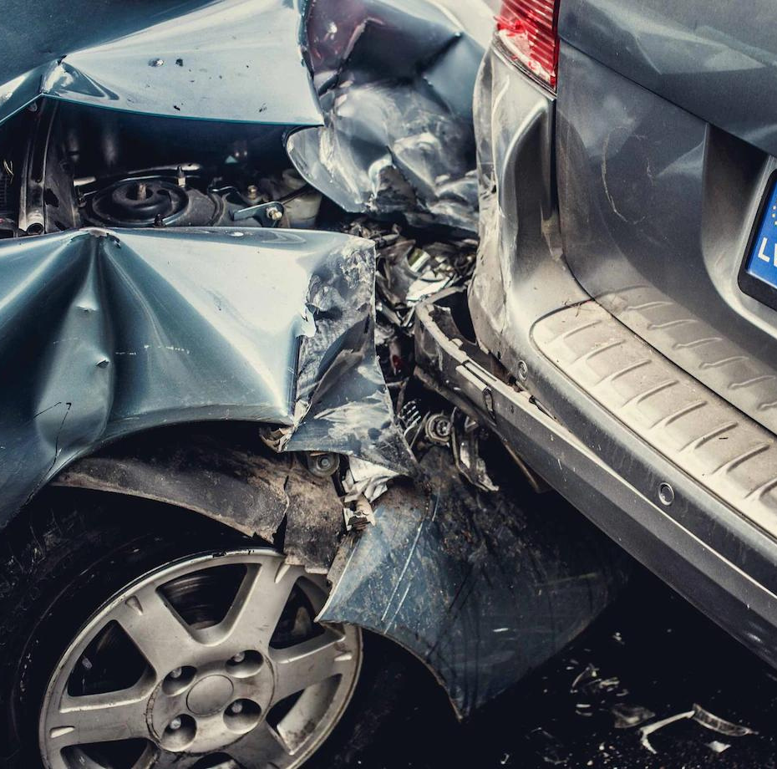
PART 2
ROAD ACCIDENT STATISTICS

Slide 7
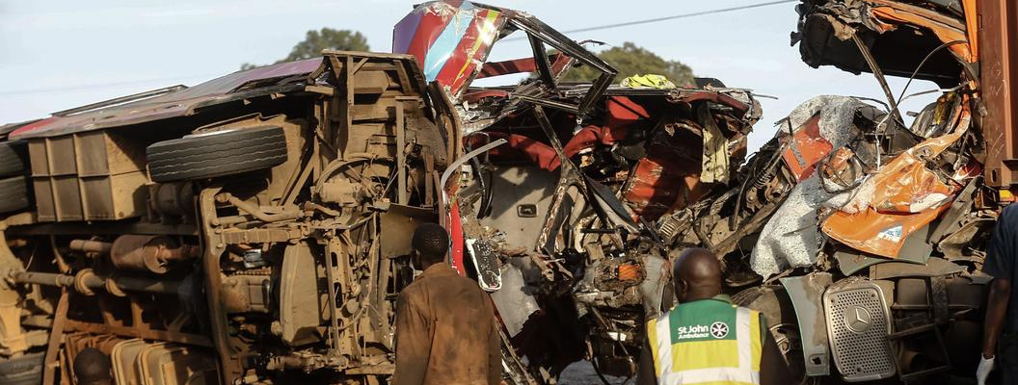
Road Accident Statistics
Road Traffic injuries (RTIs) are among the ten leading causes of death worldwide.
Road Safety Awareness
RTIs cause more than 1.35 million deaths a year and 20-50 million injured or disabled persons in the world.
The estimated economic loss due to RTIs is as high as 3%- 5% of affected country’s Gross Domestic Product (GDP).

Slide 8
Road Safety Awareness
In the African region, the average annual fatality rate now stands at 20.1 deaths per 100,000 populations in developing countries compared to 8.7 deaths per 100,000 populations in developed countries (Manyara, 2016).
Comparatively, Kenya has one of the highest fatality rates with 34.4 deaths per 100,000 populations in the world (WHO, 2013).
Over three thousand people are killed annually on Kenyan roads. A four-fold increase in road fatalities has been experienced over the last 30 years. Pedestrians and passengers are the most vulnerable; they account for 80% of the deaths.
Annual Road Crash Statistics In Africa and Kenya

Slide 9
Road Safety Awareness
93% of the world's fatalities on the roads occur in low- and middle-income countries, even though these countries have approximately 60% of the world's vehicles.
Road traffic injuries are the leading cause of death for children and young adults aged 5-29 years.
Road traffic crashes cost most countries 3% of their gross domestic product.
More than half of all road traffic deaths are among vulnerable road users: pedestrians, cyclists, and motorcyclists.
More than 75% of road traffic casualties are economically productive young adults.
Road Traffic injuries Facts

Slide 10
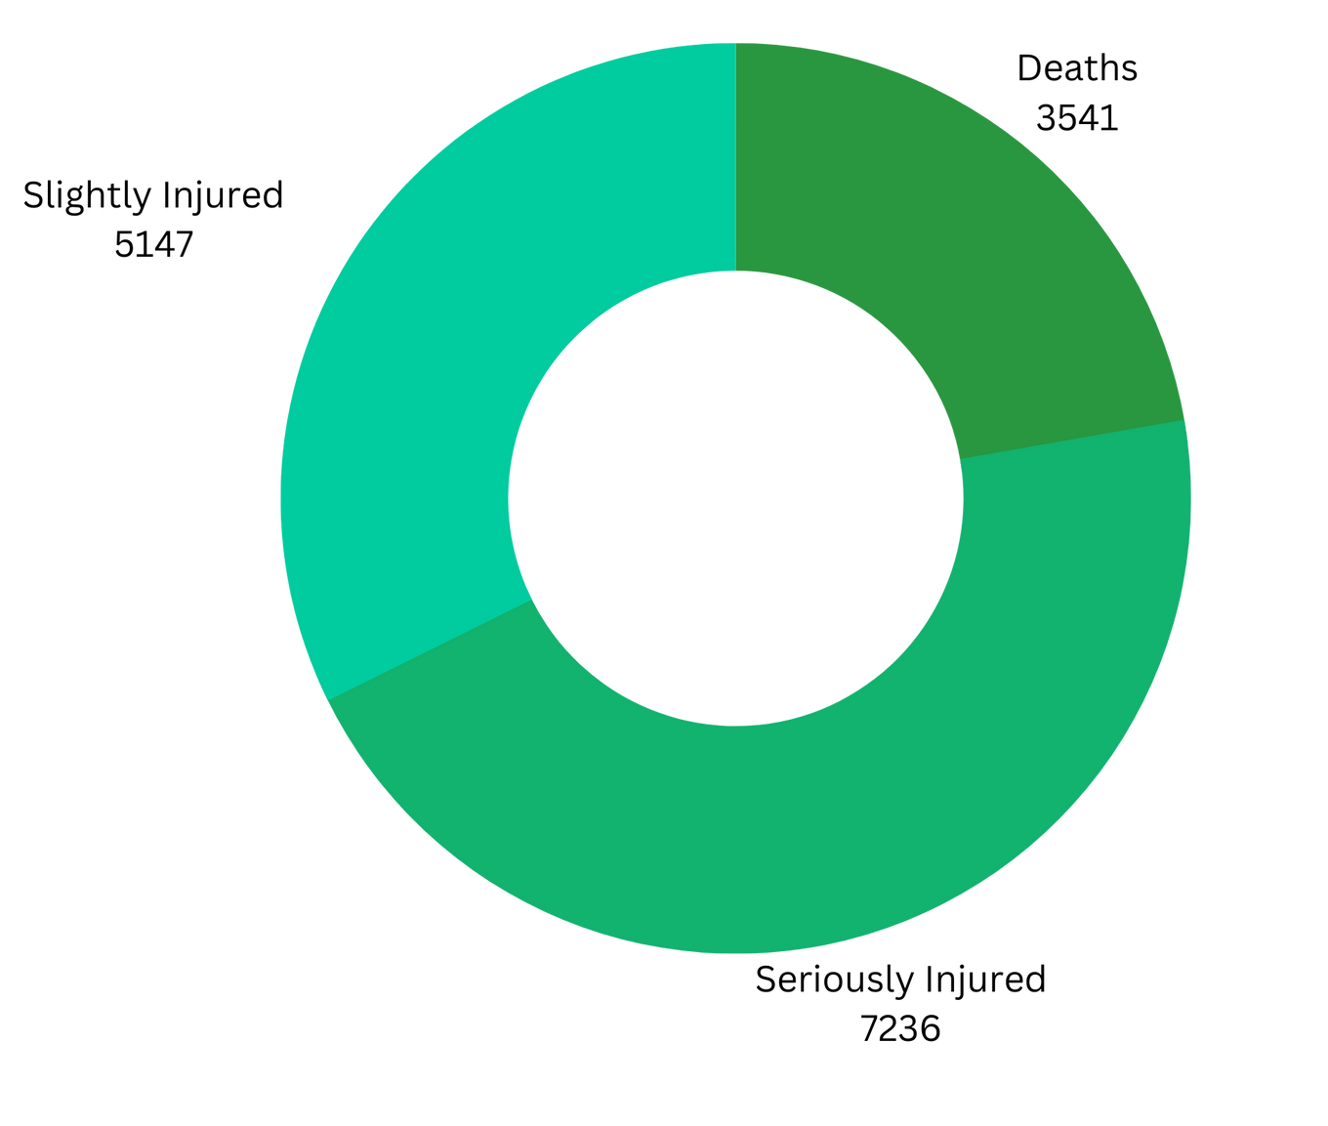
RTI's Statistics As At 26th September, 2022
Road Safety Awareness
Approximately 6,500 seriously injured victims die in hospitals, which are not accounted for in the reports provided by National Police Service and the World Health Organization

Slide 11
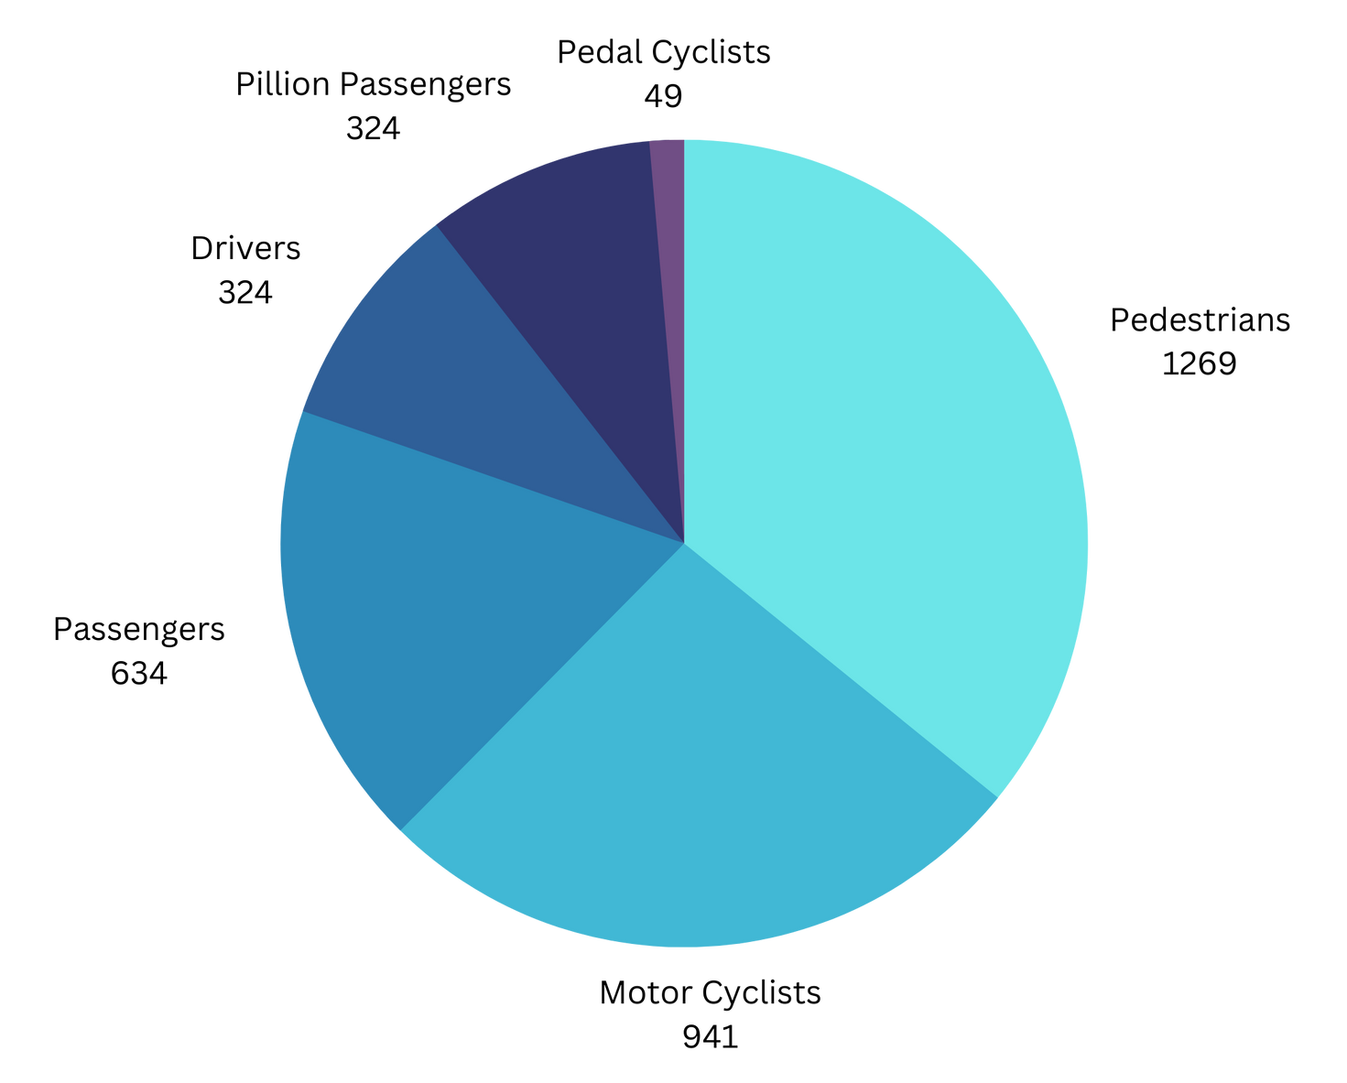
Statistics Of Deaths Arising From RTIs In 2022
Road Safety Awareness
Kenya has recorded a total of 15,924 road accidents between 1st January and 26th September 2022, the National Police Service has said.
More than 75% of road traffic casualties are economically productive young adults.

Slide 12
Comparison between 2021 and 2022 RTIs Deaths in Kenya.
 | 2022 | 2021 | % VAR
Pedestrians | 1269 | 1144 | 10.93
Motor Cyclists | 941 | 912 | 3.18
Passengers | 634 | 527 | 20.3
Drivers | 324 | 314 | 3.185
Pillion Passengers | 324 | 326 | -0.613
Pedal Cyclists | 49 | 63 | -22.22
TOTAL | 3451 | 3286 | 7.8
Road Safety Awareness

Slide 13
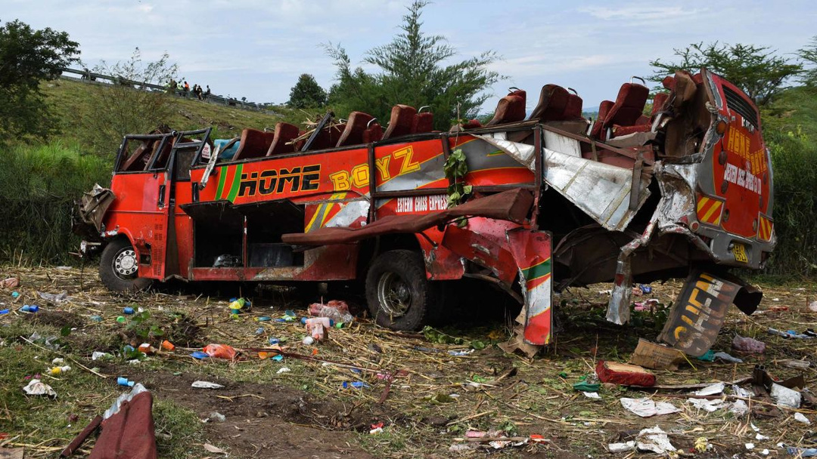
PART 3
MAJOR CAUSES OF RTIS IN KENYA
Corruption
Unqualified drivers
Road Safety Awareness
Faulty Speed Limiters
Over Speeding
Driver Fatigue
Drunk Driving
Not using seat belts
Poor Road Infrastructure
Unroad worthy vehicles

Slide 14
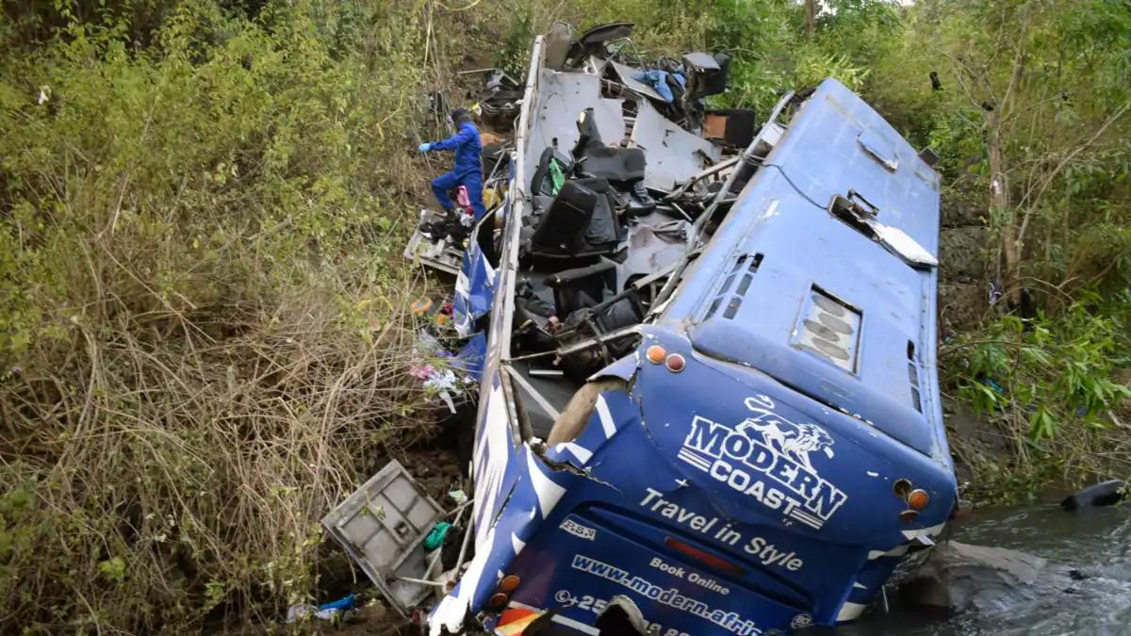
CONT.
Poor response time by ambulances when accidents occur
MAJOR CAUSES OF RTIS IN KENYA
Crossing of roads by pedestrians at undesignated places
Road Safety Awareness
Overloading goods and excess passengers
Failure to observe traffic rules.
Boda boda ignoring traffic rules, including failure to wear reflective jackets to boost visibility and speeding.
Exceeding limits and late night travels

Slide 15
In Kenya, about 3,000 road deaths occur annually and cost the country up to Kshs.300 Billion (about 5% of GDP). Statistics from the Department of Civil Registration show that about 6,500 persons die because of road traffic injuries every year and many more are injured.
Most families lose their breadwinners leaving them more vulnerable and poor.
Long-time recoveries for those involved in road accidents.
In most cases, the victims become physically challenged which inhibits them from working in various sectors or losing their jobs entirely.
Major financial losses arising from hospital bills and property damages.
Some survivors suffer from mental health issues such as PTSD (Post Traumatic Stress Disorder).
Road Safety Awareness
PART 4
BURDEN OF ROAD TRAFFIC CRASHES AND INJURIES

Slide 16

PART 5
ROAD SAFETY POLICIES & PROCEDURES

Slide 17
Road Safety Awareness
They assist all relevant Ministries, Departments and Agencies in developing and implementing effective and efficient Road Safety Policies that will promote road safety in the Public sector and prevent and manage road crashes and fatalities in Kenya.
The guidelines provide you with clear and simple procedures for developing awareness of Road Safety and subsequent guidance on developing and implementing a working programme on Road Safety.
The guidelines will be a reference point for providing civic education to the public.
Why Do We Need Road Safety Policies & Guidelines?

Slide 18
ROAD SAFETY POLICIES
Objectively verifiable indicator(s)
Objective
Description Of Action
Means Of Verification
Road Safety Management and Coordination
To manage road safety mainstreaming plans and activities effectively and efficiently by relevant organizations
Implementation of the work plan on road safety mainstreaming
Establishing and sustaining collaborations and partnerships to support road safety programmes
Policy in place
Work plans implemented
Monitoring and evaluation of reports
Policy documents
The use of media to spread awareness of road safety to the public
Speed Management Policy
To minimize speed related traffic collisions
Speed limiters to be fitted in the official vehicles
Adherence to all regulatory speed limits on the roads
The speeds to be reduced to 30kph in areas with a high number of pedestrians i.e. around schools, hospitals, markets, estates etc.
Speed monitoring systems in place e.g traffic and body cameras for police officers
Cancelling driving licenses of drivers who violate the policy
Incidence reports
Policy documents
Regular inspection of all PSVs and Commercial vehicles by NTSA

Slide 19
ROAD SAFETY POLICIES
Objectively verifiable indicator(s)
Objective
Description Of Action
Means Of Verification
Training and Education Policy
To support training, education and development programs to produce safe and qualified drivers
To ensure that training institutions for drivers are accredited
Conduct a training analysis to determine what driver training programs would be best for different drivers
Develop a policy on accrediting training institutions
Policy formulated and implemented
Increased level of awareness and competency in road safety among drivers
Annual Training plans in place
Training reports and the number of trained and qualified drivers
Provide advanced training for specific vehicles
To check the accreditations of driving institutions
(Anti-)Drunk & Drug Driving Policy
To reduce drunk driving related road traffic crashes and injuries through Zero tolerance for alcohol in the workplace and journeys for all staff, clients and contractors
Ensure that drivers and the general public are continually reminded about the effect of alcohol on driving performance.
Zero alcohol consumption when driving at all times
Consider severe penalties for drinking and driving, including dismissal and Liaising with the Authority to deal with drunk drivers
Policy formulated and promotional campaigns undertaken to educate the public
Drunk driving monitoring systems in place e.g the use of alcoblows
Reports on drunk and drug driving incidences
Policy documents
Drink and Drug driving is one of the major risk factors associated with vehicular crash. About 25% of all road fatalities globally are attributed to alcohol and other drugs.

Slide 20
ROAD SAFETY POLICIES
Objectively verifiable indicator(s)
Objective
Description Of Action
Means Of Verification
Safe Road Design
The designs of our roads should encourage appropriate road user behaviour and safe speeds.
Centre barriers and medians on rural roads
Roundabout treatments at the intersection
Removal/barrier protection of roadside hazards Greater use of rumble strips
Policy formulated and implemented
Increased level of awareness of road designs when driving
Construction of good road designs that must be approved by the appropriate authorities
Safe Speed Design
Safe speeds – that should suit the function and level of safety of the road.
Road users understand and comply with speed limits and drive to the conditions
Rural road speed limits based on the level of road protection
More 80km/hr speed zones where 100km/h open road limit is not safe
Encouraging less than 40km/hr in Urban zones
Policy formulated and promotional campaigns undertaken
Speed monitoring systems in place e.g traffic and body cameras for police officers
Putting up road speed signs at the designated areas
Issuing fines to drivers who do not comply with the speed limits

Slide 21
Provides a framework for mainstreaming of road safety in MDAs
Road Safety Awareness
It ensures road safety issues are an integral part of all activities across all Government programmes through Ministries, Departments and Agencies that actively engage in developing and implementing policies and activities to prevent and manage Road Traffic injuries and fatalities.
Advantages of Road Safety Policies & Guidelines
Reduces the number of actual or potential road traffic crashes and injuries
This ensures that motorists and pedestrians are alert whenever they use the road at any given point in time and to be aware of their surroundings.

Slide 22
Road Safety Awareness
Enhances compliance with the traffic law and regulations
This minimizes risks of penalties and conviction for traffic offences and ensures that the public follows the laws and regulations put in place to safeguard and protect themselves from causing or becoming a part of an accident(s).
Advantages of Road Safety Policies & Guidelines
Provides a mechanism for informed road safety decisions
These include driver training, staff road safety induction and sensitization; and vehicle purchase and identifying where health and road safety improvements can be made.

Slide 23
Road Safety Awareness
Reduces and controls costs
Costs such as wear and tear, fuel, insurance premiums, legal fees and claims from employees and third parties, fewer vehicles off the road for repair as a result of road crashes and injuries can be effectively reduced annually.
Advantages of Road Safety Policies & Guidelines
Promotes a culture of safe driving by the public
This prevents and minimizes road traffic crashes and injuries involving pedestrians, motorists and cyclists. Some examples are the use of safety belts at all times when one is driving, not driving under the influence of alcohol, not using ,mobile phones while driving etc.

Slide 24
Acts and Regulations
The guiding Framework for implementation of the Road Safety Policy Guidelines
The NTSA Act 2012
Pharmacy and Poisons Act (Cap. 244)
Work Injury Compensation WIBA 2007 Act
In Kenya, speed limiters are a mandatory requirement for all Commercial Vehicles and Passenger Service Vehicles (PSVs).
The KS 2295-1:2018 standard specifies requirements for the performance and installation of devices designed to limit the maximum road speed of motor vehicles by control of engine power.
Highlights prescriptions and effects of use of certain pharmaceutical drugs some that have effects on drivers while on the road.
Sets out a compensatory framework for all work related injuries.
The Kenyan constitution 2010
The Occupational Safety and Health ACT, 2007
Traffic Act
Highlights the rights of every Kenyan citizen including protection to the fundamental right to life.
The Act sets out all traffic offences and penalties for cases such as the use of seat belts.
Provides for the safety, health and welfare of workers and all persons lawfully present at workplaces.
This includes driving or riding at work, whether in a company vehicle, a hired vehicle or the employee’s own vehicle.

Slide 25

Road Safety Awareness
How To Enhance Road Safety Policies and Procedures

Slide 26



Use of Safety Belts
Seat belts are the best defense against impaired, aggressive, and distracted drivers. Being buckled up during a crash helps keep you safe and secure inside your vehicle; being completely ejected from a vehicle is almost always deadly.
Road Safety Awareness
Use of Speed Limiters
All PSVs and Commercial vehicles must be fitted with
regulated digital speed limiters as per the NTSA regulations.

Slide 27

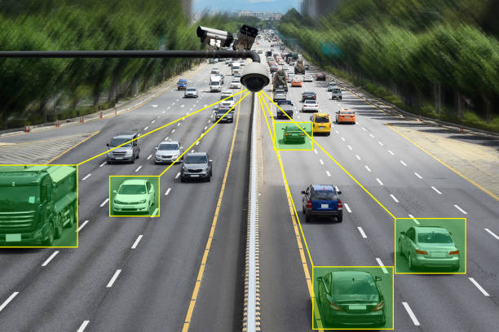
Use of Retro-Reflective Materials
The National Transport and Safety Authority requires all motorists to make themselves and commercial vehicles highly visible through the use of reflective safety markings on the rear and sides of heavy goods vehicles such as trucks, trailers, school buses and other large vehicles.
Road Safety Awareness
Use of Traffic Cameras
They can help monitor and capture traffic offenders who do not follow the traffic rules and are a danger to other motorists.

Slide 28
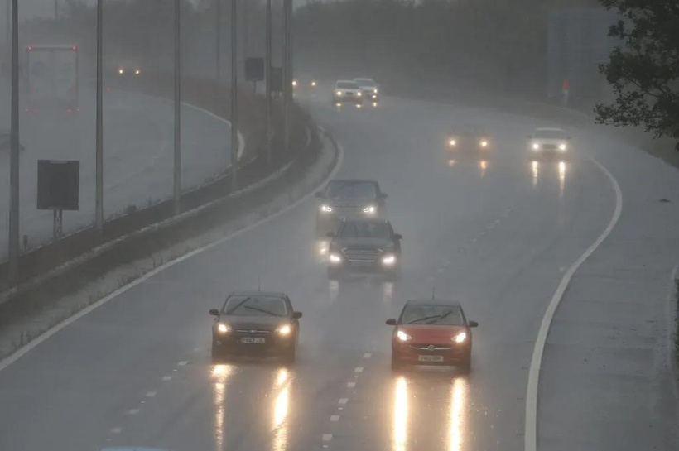

Drivers to Use Daytime Running Lights
They should be used to help drivers navigate through poor light conditions such as in foggy areas. They work great as a way to identify the car using them to other cars on the road.
Road Safety Awareness
Installation of Overhead Lights on Trucks
They can help increase the visibility of trucks on the road especially at night or in areas where there are poor light conditions.

Slide 29
Use designated bridges while crossing roads
Road Safety Awareness
Always fasten your seat belt
Obey the traffic rules
Road Safety Tips
Don't drink and drive
Slow down
Measures that motorists, cyclists and pedestrians should follow while on the road
Walk safely
Use car seats for babies
Keep your distance while driving
Avoid distractions when driving such as using mobile phones

Slide 30



Safety NOW Means
NO ACCIDENTS LATER
Others Need You As Much As We Do

Slide 31


Thank you!
Road Safety Association of Kenya
0746 736525
info@roadsafetyassociationofkenya.org

